Slide 1
Battle of Neighborhoods
Determining Appropriate Location for Warehouse of Restaurant Raw Materials Supplies Business
By: Prateek vashishtha

Slide 2
Contents
Introduction
Proposed Solution
Methdology
Analysis
Results
Conclusion

Slide 3
Introduction
Fooracles need to decide location to start warehouse for raw material supplies to restaurants in New Delhi
Raw materials are supplied to restaurants on daily basis by vendors
Cost of transportation needs to be reduced and also time taken to supply
More appropriate location is always that has maximum restaurants in close vicinity
Starting location to consider is New Delhi central location coordinates

Slide 4
Proposed Solution
Using geo location data of coordinates of neighborhoods in New delhi can be used
Determining the count of restaurants in close vicinity to multiple locations
Comparing suitable locations for building up warehouse
Finding which location has maximum number of restaurants approachable easily in less time and with minimum transportation cost

Slide 5
Methodology
Foursquare API is used to get JSON format data that contains neighborhood data of New Delhi
JSON file is parsed to get data in raw format
Data is then converted to Pandas DataFrame in Python
Data is then further mined deeper to get more neighborhoods in detail
Detailed data is segmented to get only data related to restaurants
This data is then used to get distance from chosen points and analyzed to get count of restaurants in close vicinity to chosen center

Slide 6
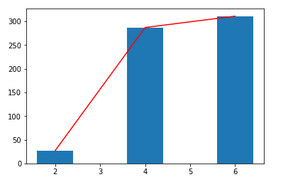
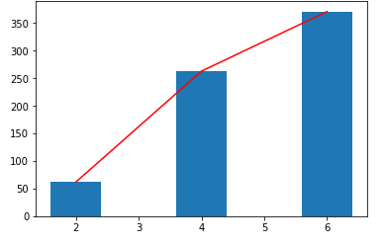
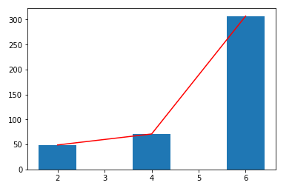
Results
New Delhi Central Sevilla Rajinder da Dhaba

Slide 7
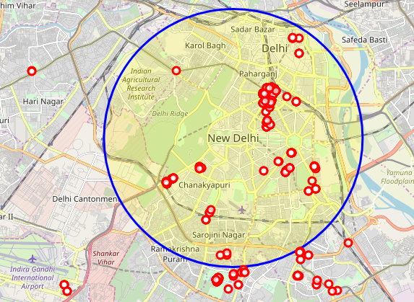
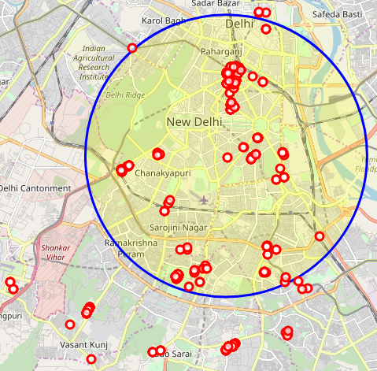
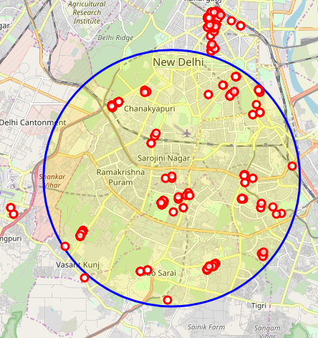
Results Cont…
New Delhi Central Sevilla Rajinder da Dhaba

Slide 8
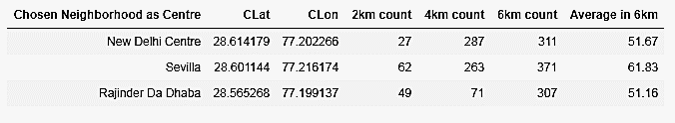
Results Cont…
Results shows that more restaurants are available in close vicinity to Sevilla neighborhood

Slide 9
Conclusion
On basis of analysis we can advice Fooracles suitable location to start new business as Sevilla
Sevilla neighborhood contains main areas of business as Khan Market, Lodhi Estate or Nehru Palace
More analysis can be done using detail data of restaurants and pricing data of locations to rent or buy a property

Slide 10
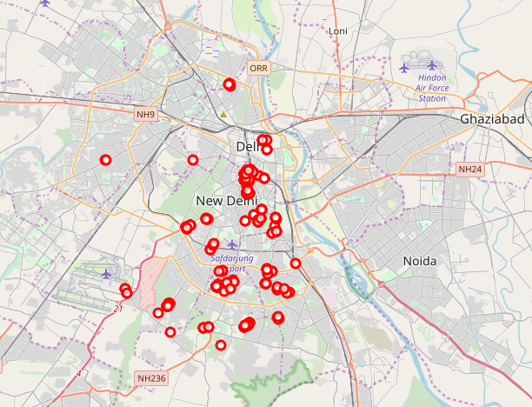
Thanks You

